Slide 1
Pre-discovery (aka initiative scoping)
Collectively finding and shaping the next steps for future action
July 2019

Slide 2
About these guidance notes:
These come from collaborative sessions in July that were to help all of the lab team have a common understanding of Pre-discovery, its outputs and the range of ways to deliver it.

Slide 3
What’s a pre-discovery?
This occurs when an agency customer / third party wishes to find out what it would take explore something further beyond engagement
It’s a 1-2 week phase of work that builds on engagement work already done to determine next steps for piece of work

Slide 4
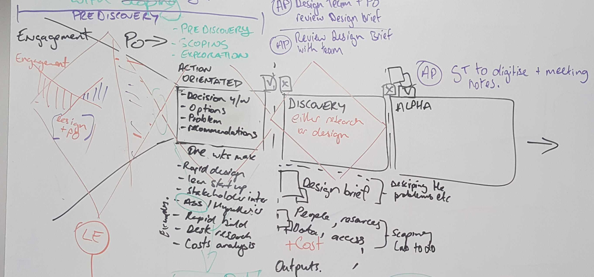
1. An additional step has been included after conversation between design and engagement teams with the goal to improve the quality of projects as they enter a discovery or alpha from the engagement phase.
It would be a 1-2 week pre-discovery (scoping) that builds on information gathered during engagement and brings the interested parties to help scope up initial work with the goal being a tighter design brief/SoW to start a project.
2. As the engagement activities continue, product owner, design and scrum masters get more involved to help plan and run the pre-discovery (scoping activities).

Slide 5
Why do we need to do a pre-discovery?
Provides us a place to start a piece of work
Our lab team does not have a unified knowledge of this phase and ways to deliver it
To achieve better handover of work between teams
So we can better manage expectations with our customers of next steps
We are funded to do this work
Agencies need to define their integrated service scope
Some agencies don’t have the capability to do this
Creates better efficiency when starting a discovery therefore maximising our time with customers
Identify if the work should proceed

Slide 6
Outcomes from pre-discovery
A research discovery
A design discovery
No further action
Further engagement activities to get more information

Slide 7
What do we need to achieve?

Slide 8
The goal:
To get just enough information to describe in a concise way a potential initiative, for the purpose of making a decision to commit (ie funding, sponsorship, resources).

Slide 9
Who is going use the pre-discovery outputs?
As a agency partner ( or third parties),
I want to know if my idea or opportunity should be explored and developed further and what would be required to so,
So that I can seek a commitment for funding/ sponsorship etc and make a potential decision.
As a team likely to lead a discovery (ie designer, scrum, product owner),
I need a starting place that is not too broad (so I don’t know where to start) and not too narrow as to miss the opportunity to explore,
So that we can plan and start a discovery with confidence.

Slide 10
Primary outputs
The summary could be just the first two pages of design brief / statement of work. More information can be accessed if required.
Design brief / statement of work
For the team leading a potential discovery (includes lab and agency teams)
Description of work and what’s needed to set up a team
Lab design team is responsible for creating this
Two page summary
For agency decision makers
For lab engagement team to help inform / work with agency partners
Summary of the design brief / statement of work with decision points needed.
Lab design team is responsible for creating this with support from engagement team

Slide 11
Secondary outputs
Pre-discovery activities captured
For the team leading a potential discovery (includes lab and agency teams)
For future teams interested in the focus area
Activities are recorded and documented as necessary to assist re-use

Slide 12
Design brief / statement of work
“Context” for the work
Options for future action
Scope for the next phase of work
Symptoms (of potential problems)
What do we want to shift? ie desired change
Hypothesis to test
What can we start? ie something doable
What’s definitely out of scope
High level epics if known
Customer expectation for outcomes/goals for next step
Initial plan
Brief description of approach, deliverables, outcomes, ethics, timeframes for timeboxed activities.
Who needs to be involved?
Core delivery team and the skills required, supporters and people that we need to inform
Other things required?
Access to data and information if known, possible costs
Commitment to action - what traction has this work got already?
Probability of risk and responses, limitations if any.
Requirements

Slide 13
How to do a pre-discovery?

Slide 14
Lab team process
Effectively a pre-discovery is like other shaping and scoping activities - we are shaping and narrowing down the problem and designing the outline of a solution that fits our collective appetite.
In addition to facilitating the process to create the outputs we’ll need to help our agencies look to the value of what we are trying to identify and achieve vs time.
This means focusing not on “how long will it take” but instead “how long do we want to spend”

Slide 15
Who needs to be involved and when?
Engagement team throughout engagement and pre-discovery process
Design team need to be involved in engagement activities that start to explore the opportunity / problem space in more detail
Product owner and scrum masters involved when decision is made that pre-discovery is needed

Slide 16
We’ll continue to use these
Scoping A3 notes
Inception deck
Lean Canvas
SMART Goals
Op Workflow scoping notes
Current Statement of work template
Logic model design sprint

Slide 17
We can also use these tools / frameworks too
Opportunity canvas
Agile INVEST model for user stories
Design thinking Customer point of view
Hypothesis creation
Decision quality
Principles of Shaping

Slide 18
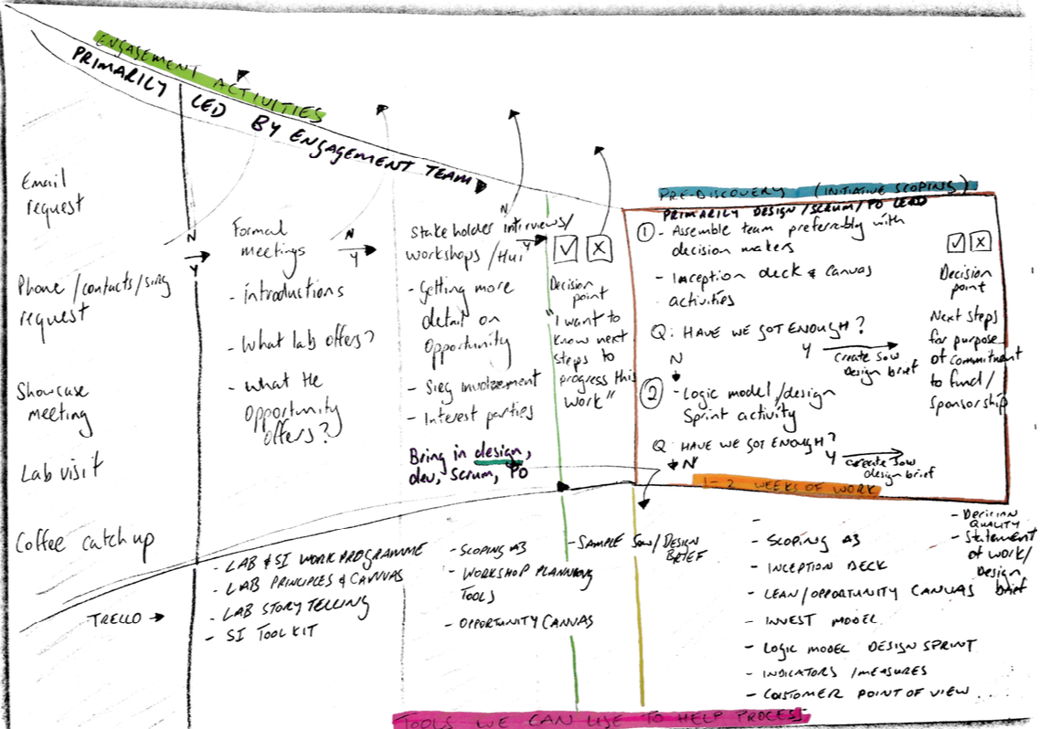
Process
The pre-discovery phase would consist of collaborative activities with the core delivery team and interested parties.
It would be informed by the work done in earlier engagement activities.

Slide 19
Straightforward vs complex initiatives
During the engagement activities it may become obvious that the initiative is reasonably straightforward or complex to work out the next steps.
For straightforward or less complex initiatives an inception deck and canvas activity maybe enough to get the required information. Example: SI toolkit, EmTech VR experiment
For complex initiatives a combination of an inception deck and canvas activity plus logic model design sprint will be needed to identify a starting point. Example: Life event and life event clusters

Slide 20
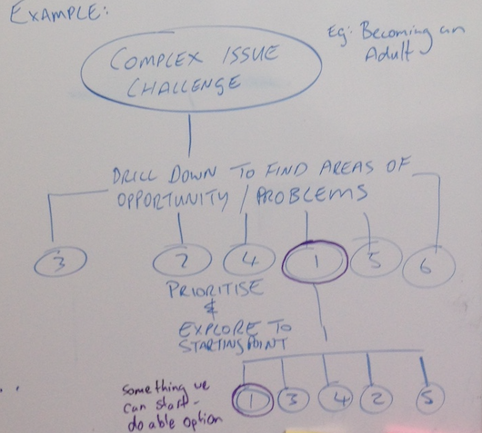
Complex initiatives
The goal will be to get enough understanding of the challenge area to drill down to create a value stream of focus areas that might help achieve the desired shift if explored.
One focus area can be prioritised and explored to find a starting point for future work. It has to be a doable option that allows the design brief / statement of work to be created.

Slide 21
Next steps
Show and tell - please advise other tools and frameworks that could be helpful to use in this phase
Please can you review these notes and make suggestions by COB 2nd August
Glen to update notes and brief team
Glen responsible for the output template(s)
Test approach on next work item that is ready for pre-discovery
Retrospective and update process as necessary

